Slide 1
Launch Day

Slide 2
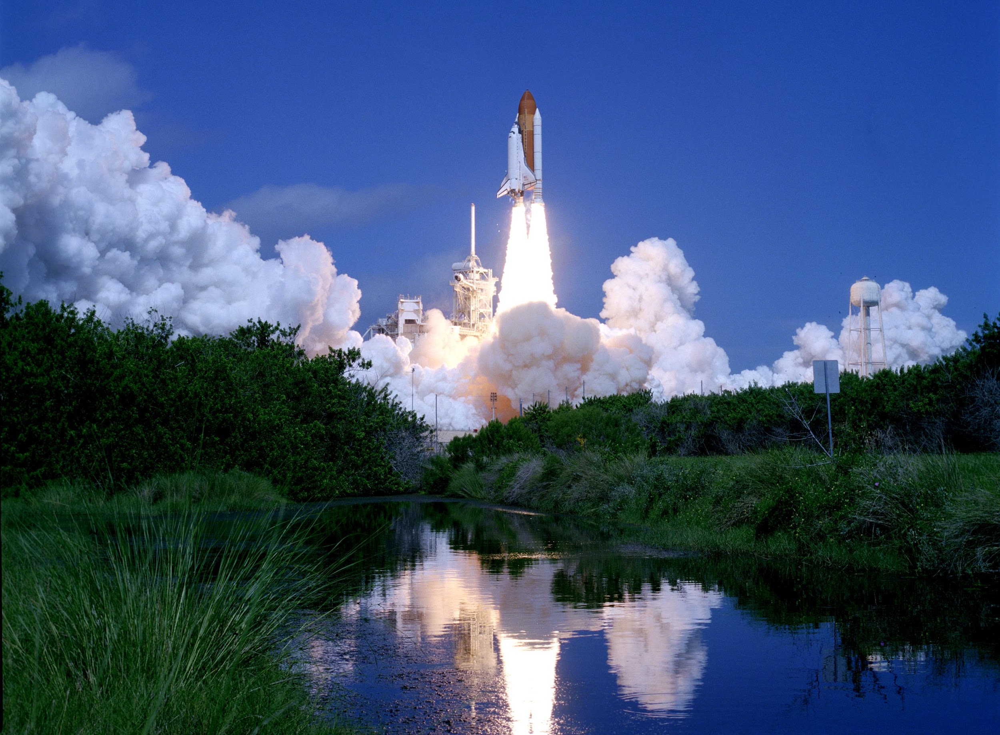

Slide 3
Launching
Unpack
Set up internet access
Start up tracker
Decode and upload
Close up payload
Flight train
Fill balloon
ATC ??
Sky clear ?
Launch!

Slide 4
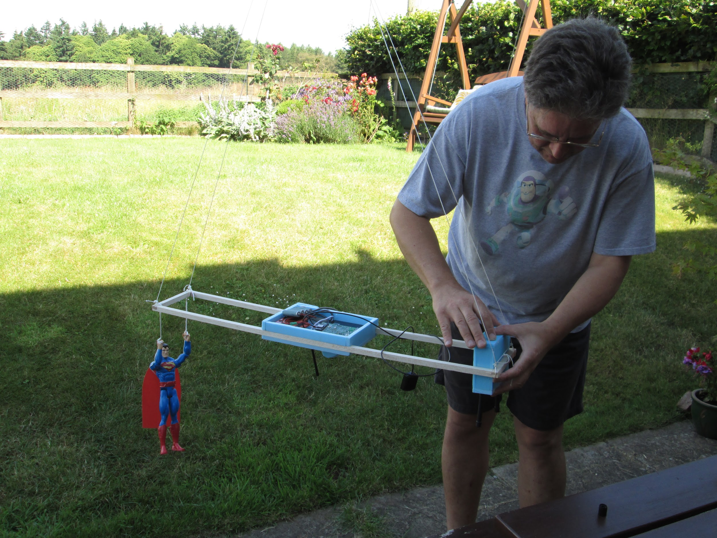

Slide 5
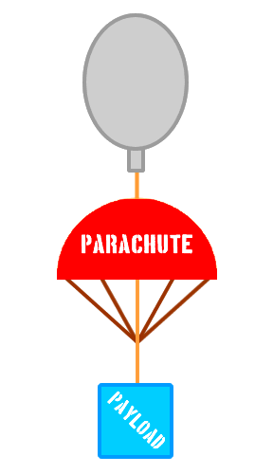
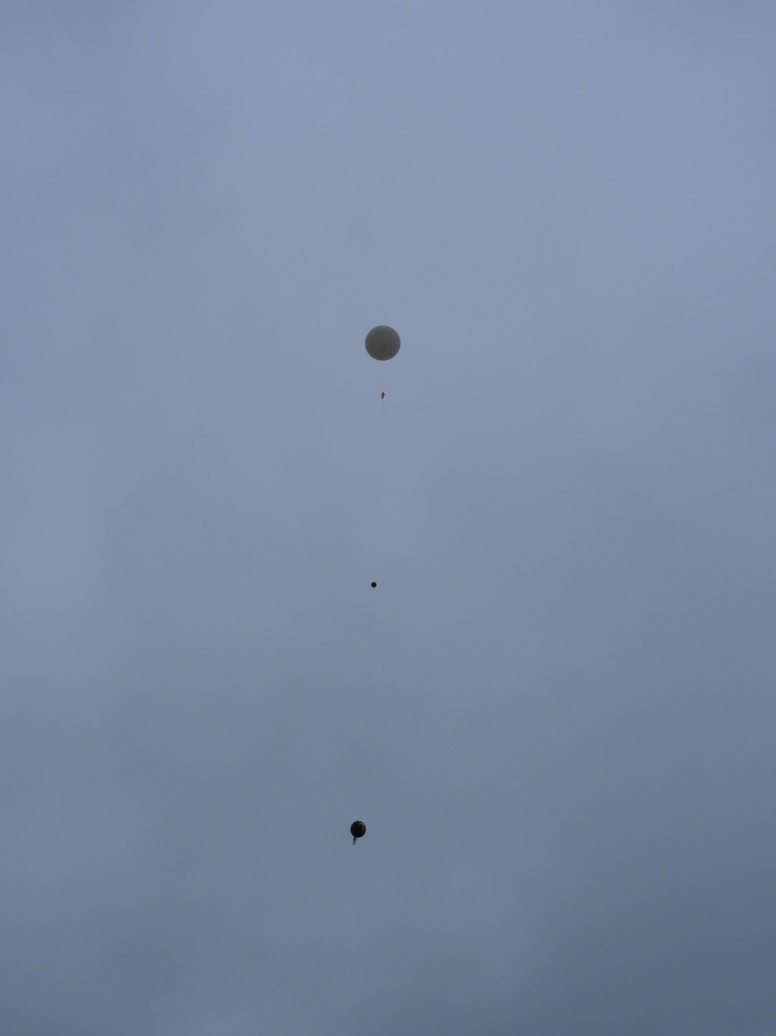

Slide 6
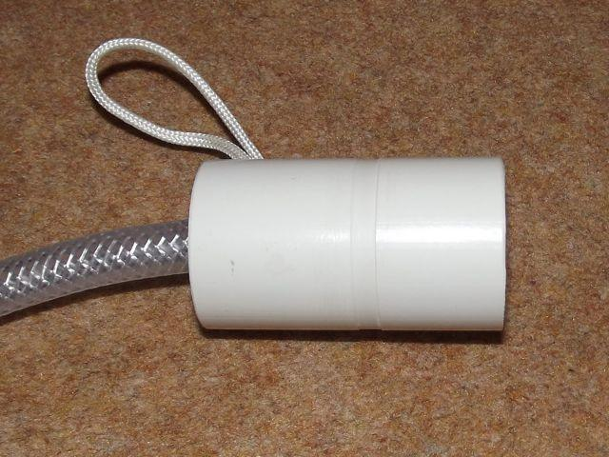

Slide 7
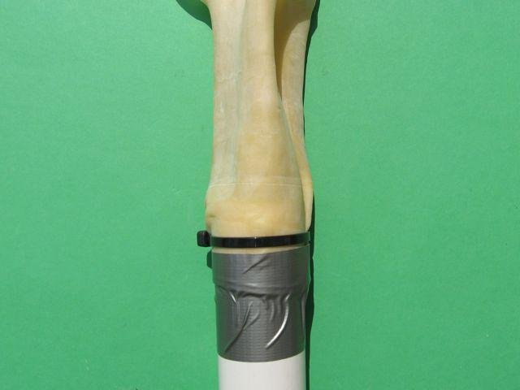
Balloon sealing images by Steve Randall, from https://ukhas.org.uk/guides:sealing_the_balloon

Slide 8
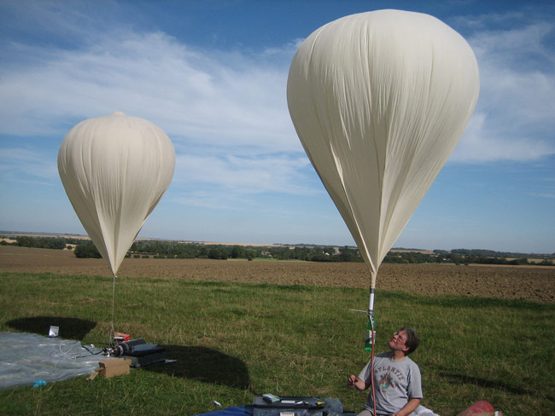

Slide 9
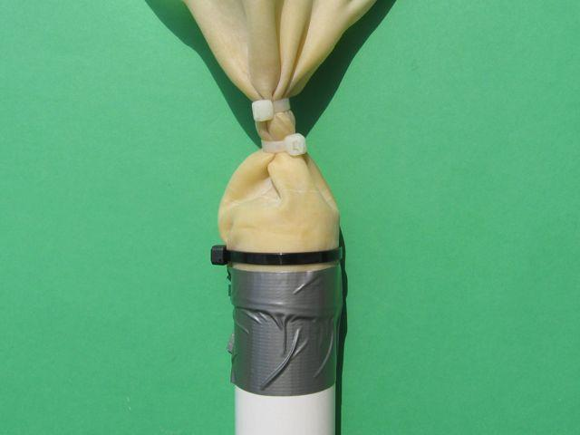

Slide 10
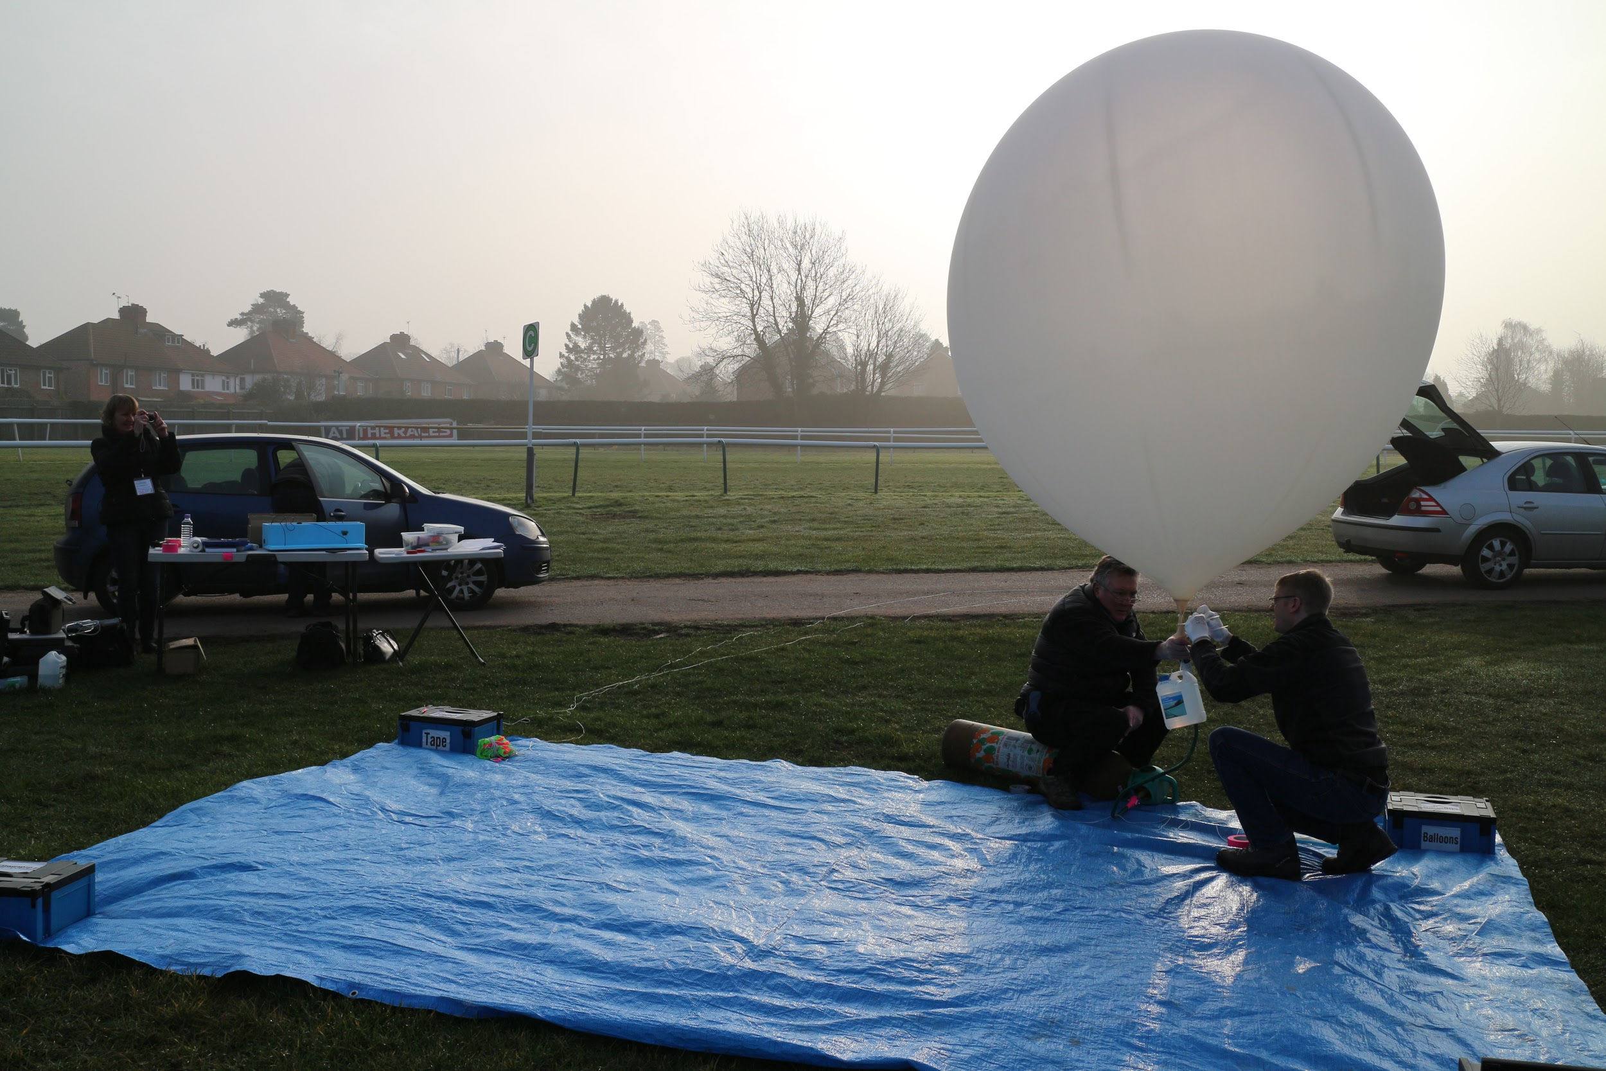

Slide 11
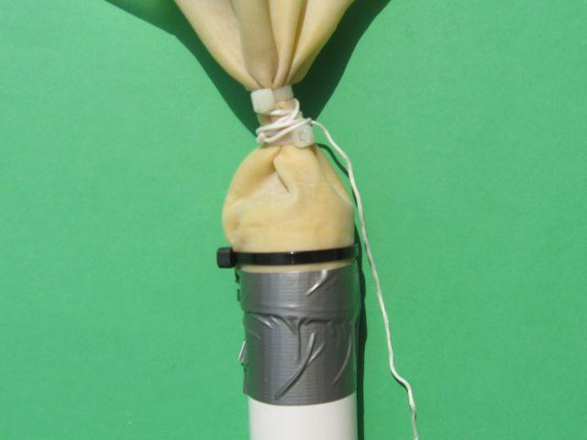

Slide 12
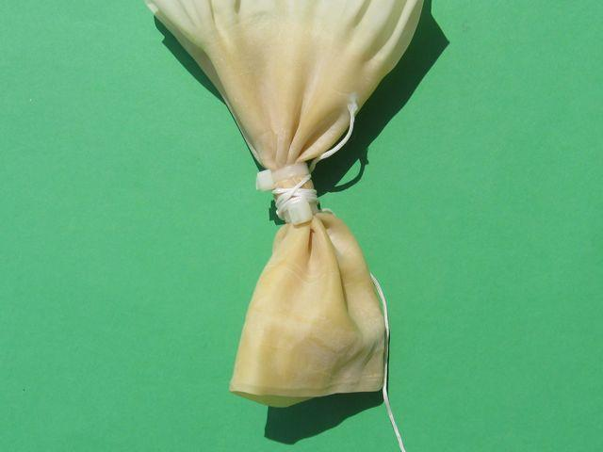

Slide 13
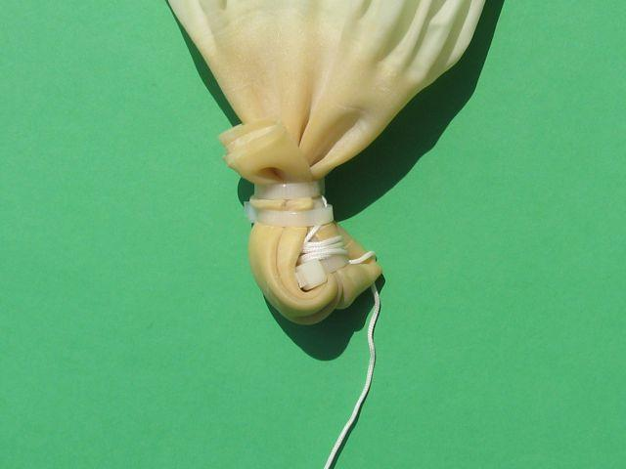

Slide 14
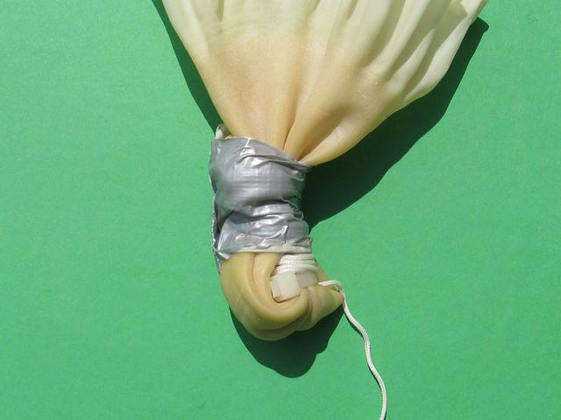

Slide 15
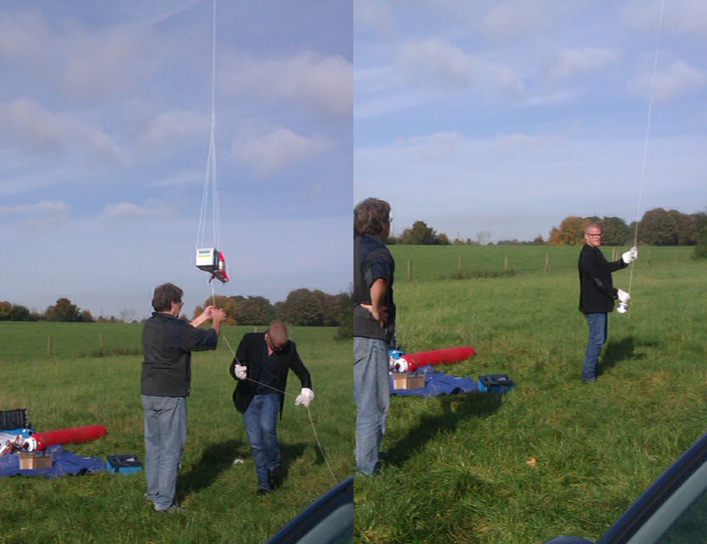

Slide 16
Chasing
Roles - Driver, Radio, Navigation, Comms
Before Burst: Drive to a suitable location with internet access and good radio signal, somewhere near predicted landing.
After Burst: Drive to update predicted landing spot
After Landing: Drive to latest position or prediction and decode landing position
After decode: Plan route by car/foot

Slide 17
Logistics

